Slide 1
GUI Controls
Notes:
References:
http://en.wikipedia.org/wiki/Graphical_control_element
http://msdn.microsoft.com/en-us/library/bb158625.aspx

Slide 2
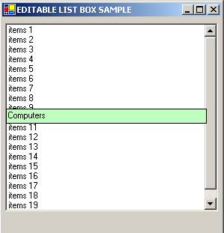
ListBox

Slide 3
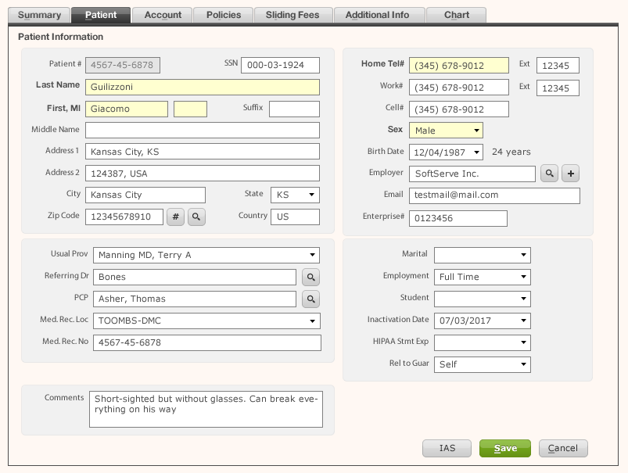
Edit Box (Text Box) & Label

Slide 4
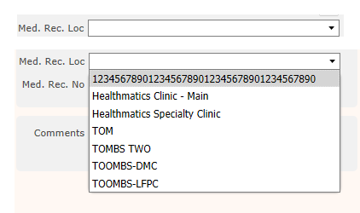
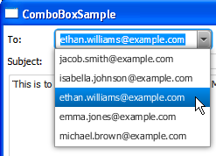
Dropdown&ComboBox

Slide 5
Button

Slide 6
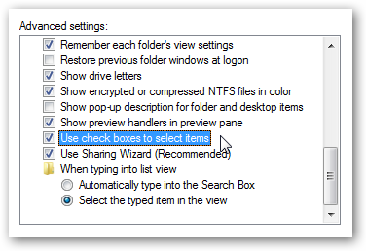
CheckBox & Radio button

Slide 7
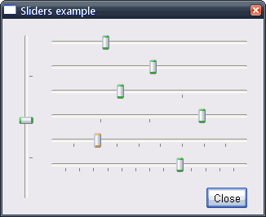
Slider

Slide 8
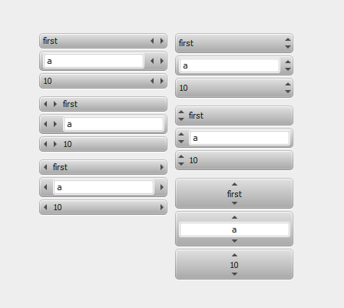
Spinner

Slide 9
Toolbar

Slide 10
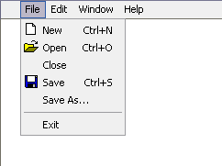
Menu & Menu bar

Slide 11
Navigation: Tab

Slide 12
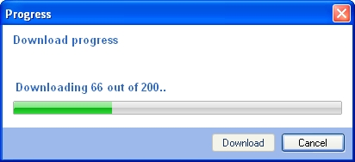
Output: Progress bar and Status bar

Slide 13
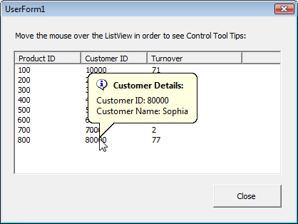
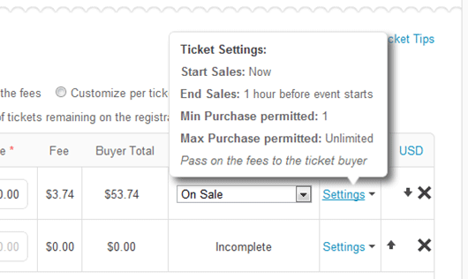
Output: Tooltip (Hint)

Slide 14
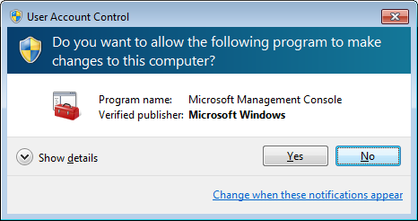
Containers: Dialog box

